Slide 1

CATTLE SKIN DISEASE CLASSIFICATION USING DEEP LEARNING

Slide 2

INTRODUCTION
OBJECTIVE
LITERATURE SURVEY
Table Of Content
BLOCK DIAGRAM
CODE
RESULTS

Slide 3

Introduction
Lumpy skin disease is a viral infection affecting cows, characterized by skin nodules, fever, and other symptoms. With no specific antiviral treatment available, early detection is crucial for effective management and prevention of spread.

Slide 4

Objective
The Objective is to train and evaluate deep learning models on relevant data related to infections causing Lumpy Skin Diseases.

Slide 5
LITERATURE SURVEY
S.NO. | TITLE | DETAILS | PROS | CONS
1 | Assessing machine learning techniques in forecasting lumpy skin disease occurrence based on meteorological and geospatial features Author: Ehsanallah Afshari Safavi Published on 14 January 2022 | The key objective of this research was to develop predictive models using ML algorithm based on meteorological and geospatial features to predict the incidence of LSDV infection in some countries. | Incorporation of Features Relevance to Prior Outbreaks Use of Machine Learning | Limited Temporal Scope Potential Data Quality Issues Scope of Countries

Slide 6
LITERATURE SURVEY
S.NO. | TITLE | DETAILS | PROS | CONS
2 | A Deep Learning Approach to Detect Lumpy Skin Disease in Cows Author: Gaurav Rai, Naveen, Aquib Hussain, Amit Kumar and Rahul Nijhawan Published on 28 February 2020 | An architecture using machine learning techniques had been developed to detect the Lumpy skin disease. The work is tested on the dataset and is measured with other advanced methodology. | High Accuracy Early Detection Potential Application | Dataset Limitation Treatment Aspect

Slide 7
LITERATURE SURVEY
S.NO. | TITLE | DETAILS | PROS | CONS
3 | Detecting High-risk Area for Lumpy Skin Disease in Cattle Using Deep Learning Feature Author: Musa Genemo Published on 15 February 2023 | Deep learning-based segmentation and classification are proposed for disease segmentation and classification. The developed framework is initially trained on a collected Cattle’s lumpy Skin Disease (CLSD) dataset. | Advanced Technique Training on a Collected Dataset Utilization of Deep Features | Computational Complexity

Slide 8
LITERATURE SURVEY
S.NO. | TITLE | DETAILS | PROS | CONS
4 | Development of a Model for the Prediction of Lumpy Skin Diseases using Machine Learning Techniques Authors: Olatayo Moses Olaniyan, Olusogo Julius Adetunji, Adedire Marquis Fasanya Published in October 2023 | An enhanced model was developed to improve the predictive performance of existing model and also, compared the performance of stacked ensemble of single classifiers with respect to optimized artificial neural network. | Application of Feature Selection Technique Improved Predictive Performance Wide Geographical Coverage | Limited Data Inadequate Description of Model Architecture

Slide 9
LITERATURE SURVEY
S.NO. | TITLE | DETAILS | PROS | CONS
5 | A Survey on Deep Learning Method to Identify Lumpy Skin Disease in Cows Authors: Toyal Mazi, S. Tharun Kumar Reddy, B. Rakesh, N. Chandu Published in January2023 | Development of a machine learning architecture that can predict or detect illness. The main goal is to exercise a deep learning method to identify the virus that causes lumpy skin condition. An efficient method for recognizing photos is based on deep learning and is known as DenseNet-121. | Early Disease Detection Objective Diagnosis Public Health Impact | Resource Intensiveness Dependency on Image Quality

Slide 10
LITERATURE SURVEY
S.NO. | TITLE | DETAILS | PROS | CONS
6 | Cow Disease (LSD) Classification System for predicting different Severity levels Author: V.Sivamurugan, K.R. Uthayan, and V. Thanikachalam Published in 2022 | In this research work, a classification system based on deep learning had been proposed for predicting the different severity levels or grades of Lumpy Skin Disease. | High Accuracy Rate Evaluation Across Multiple CNN Models Potential as a Diagnostic Tool | Generalization to Other Regions

Slide 11
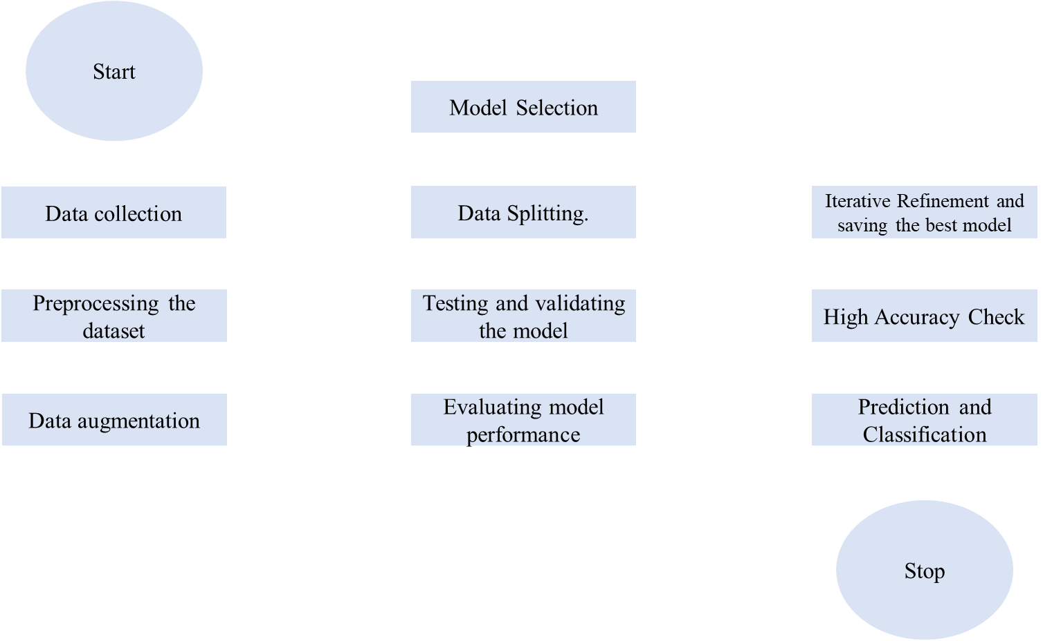
PROJECT FLOWCHART

Slide 12
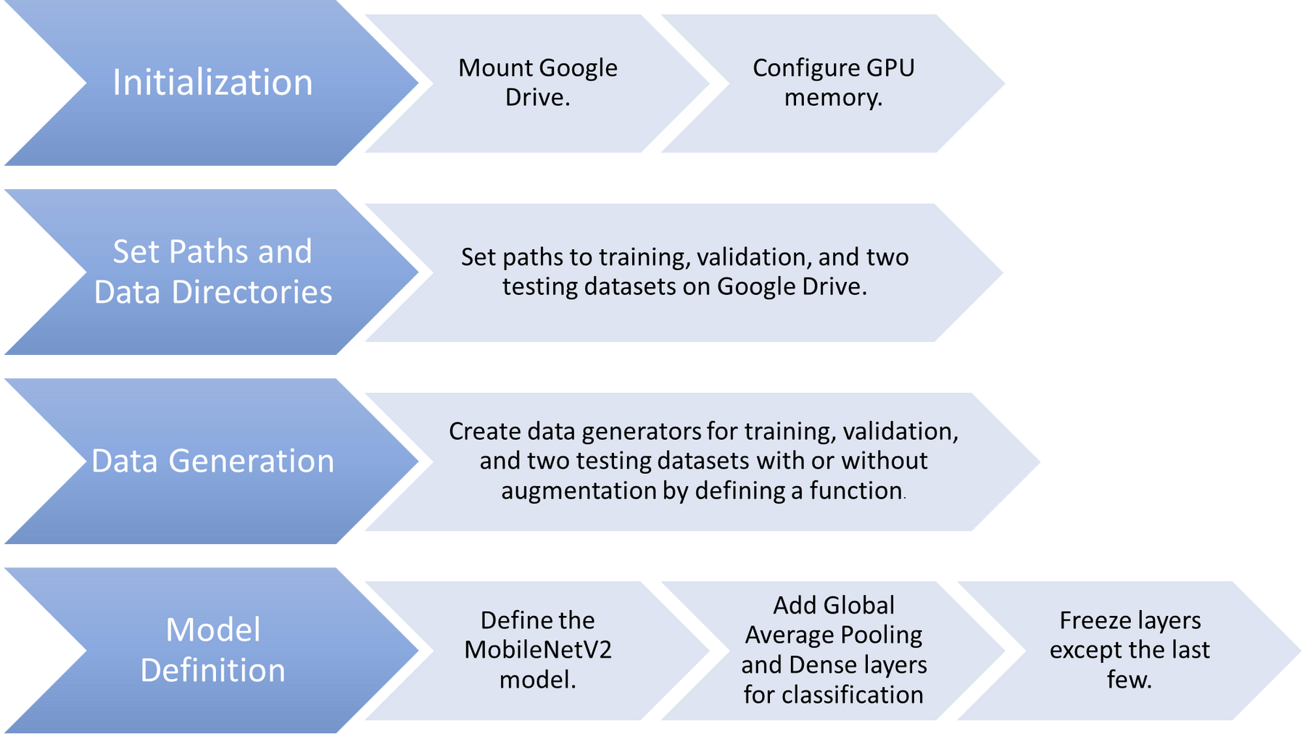
BLOCK DIAGRAM
1
2
3
4

Slide 13
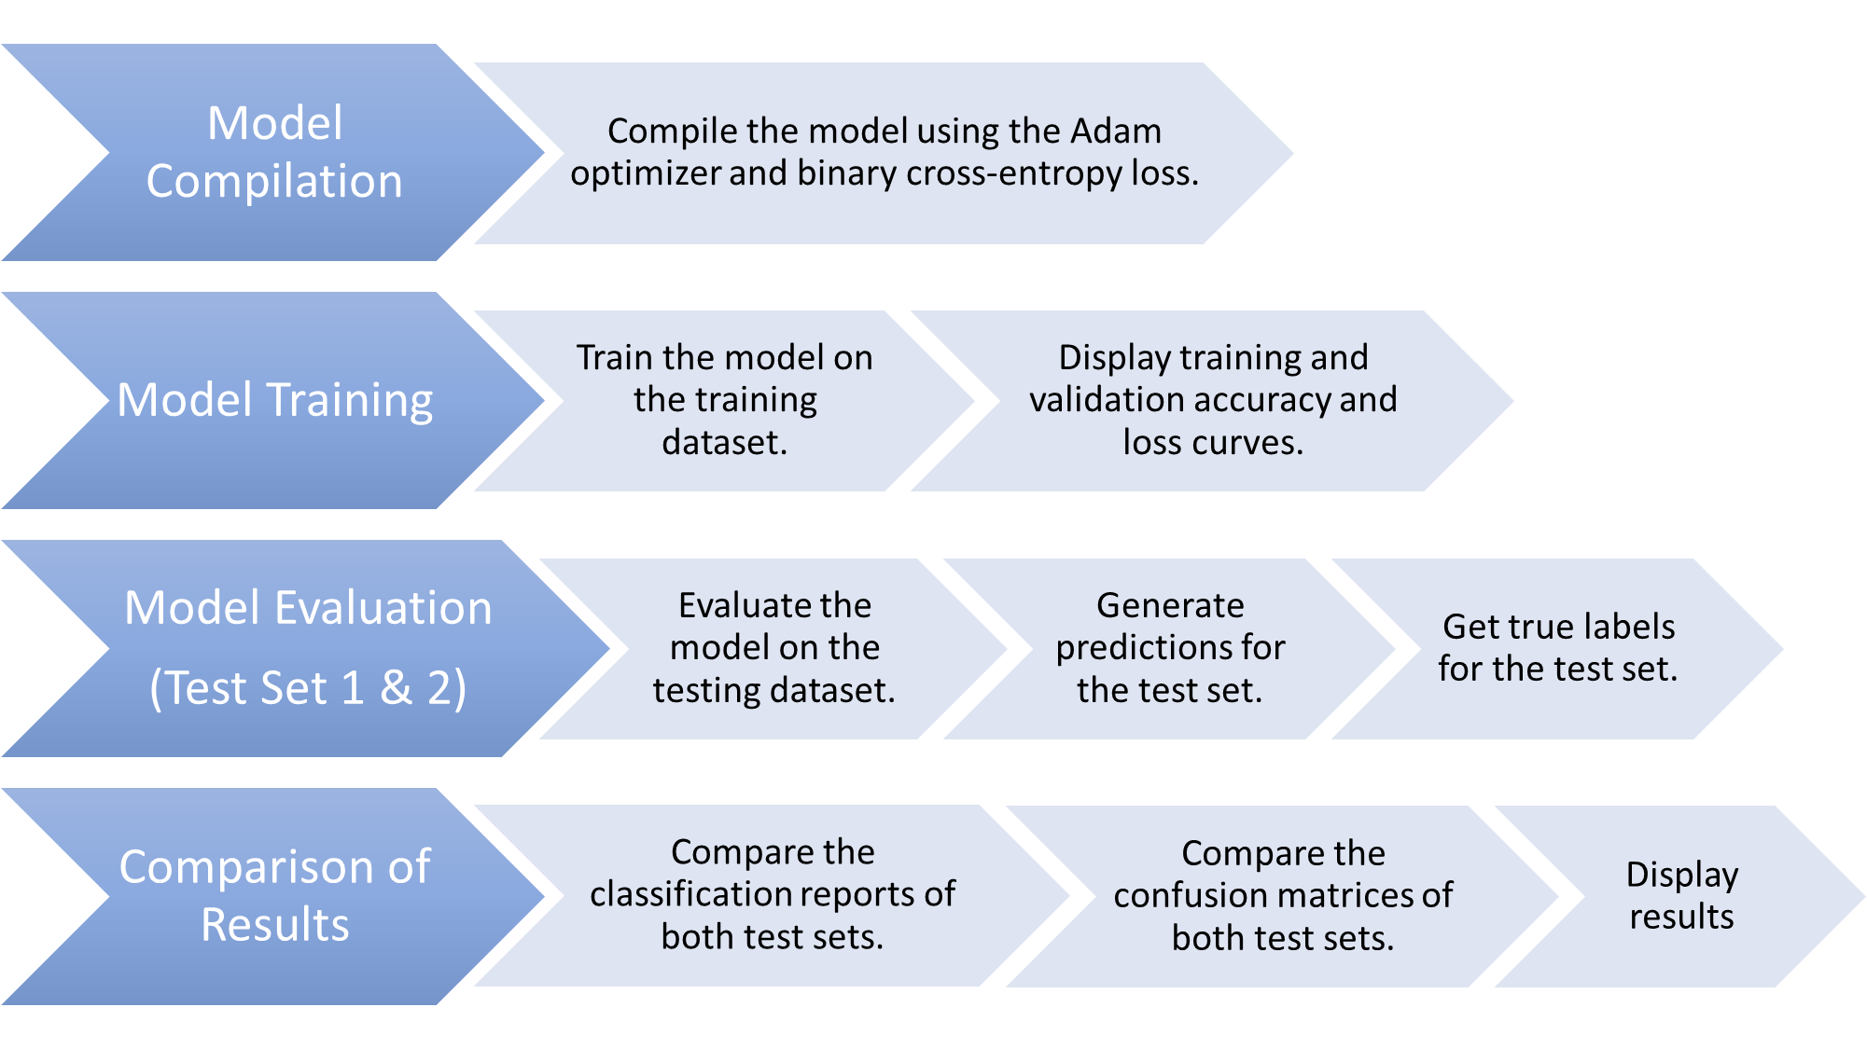
BLOCK DIAGRAM
5
6
7
8

Slide 14
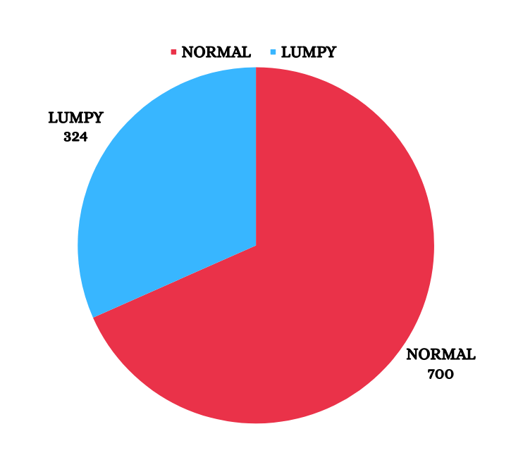
DATA COLLECTION
Types of Cow Number of Images
Normal Cow 700
Infected from Lumpy Disease 324

Slide 15
NUMBER OF IMAGES
TRAINING
Normal:560
Lumpy:260
VALIDATION
Ratio
80:10:10
Normal:70
Lumpy:32
TESTING1
Normal:70
Lumpy:32
TESTING2
Normal:5
Lumpy:3

Slide 16
AUGMENTATION TECHNIQUES
1
Rotation: up to 20 degrees, enhancing viewpoint variability in training.
  2
Width Shift: up to 20%, diversifying spatial features in data.
  3
Height Shift: up to 20%, introducing variations in object positions
  4
Shear: with 20% intensity, contributing to robustness against deformations.
  5
Zoom: up to 20%, improving model's scale invariance.
  6
Horizontal Flip: enhances model generalization by introducing mirror reflections.
  7
Fill Mode: Determines strategy for filling new pixels; uses the nearest pixel value for consistency.

Slide 17
MODEL SUMMARY: MobileNetV2
1. Input Processing:
2. Block Structure (Repeating for 16 Blocks):
Input Data
Input Layer
ConV 2D Layer
ConV 2D Layer, Batch Normalization, ReLu
Depth wise Convolution, Batch Normalization, ReLu
Projection Convolution

Slide 18
MODEL SUMMARY: MobileNetV2
3. Intermediate Layers:
  block_16_expand
  block_16_project
  Conv_1
  Conv_1_bn
4. Output Processing:
  The architecture concludes with global average pooling, followed by fully connected layers ("dense," "dense_1," "dense_2," and "dense_3").
  The final layer produces the output.

Slide 19
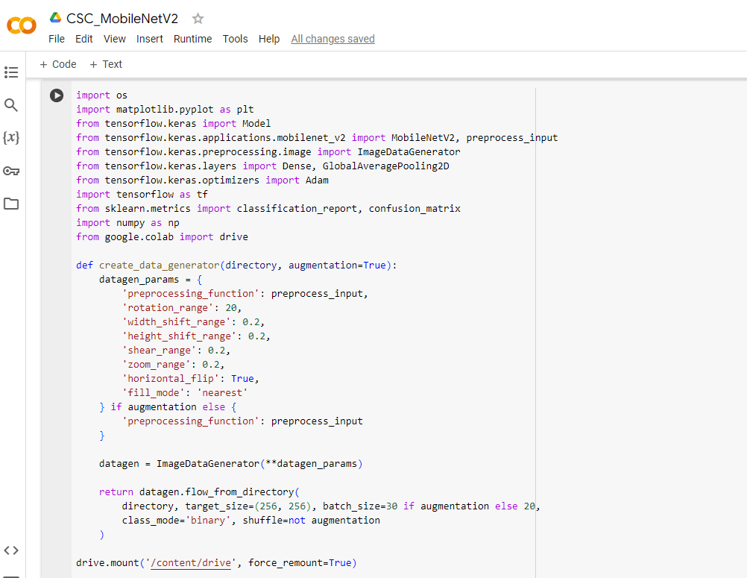
Code:

Slide 20
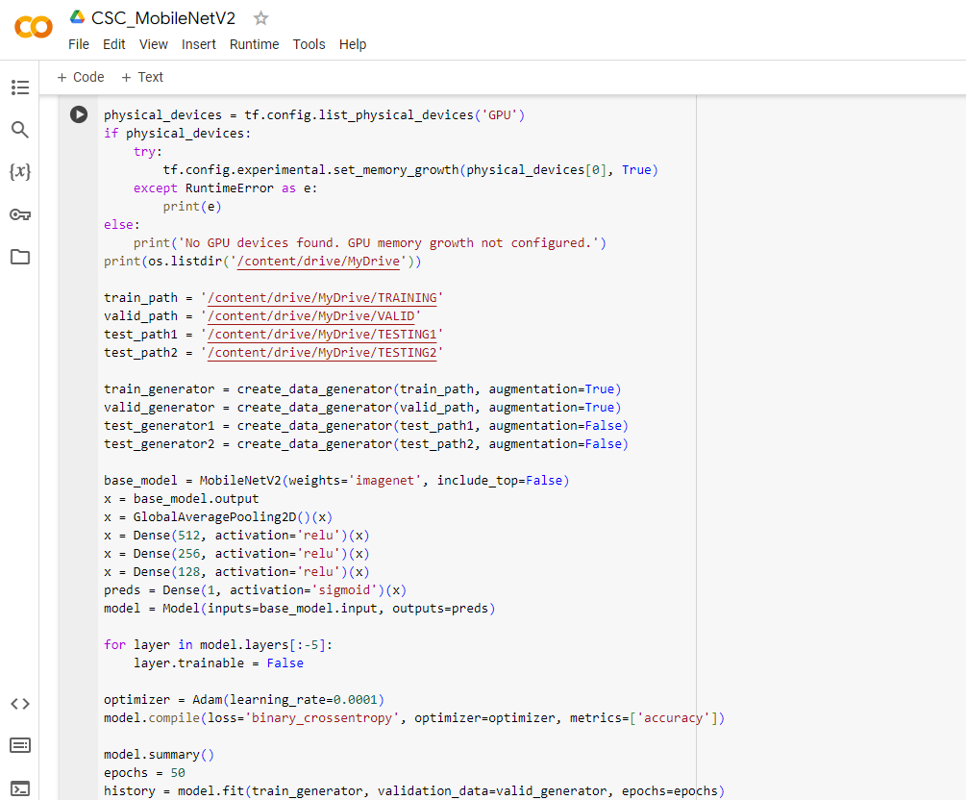

Slide 21
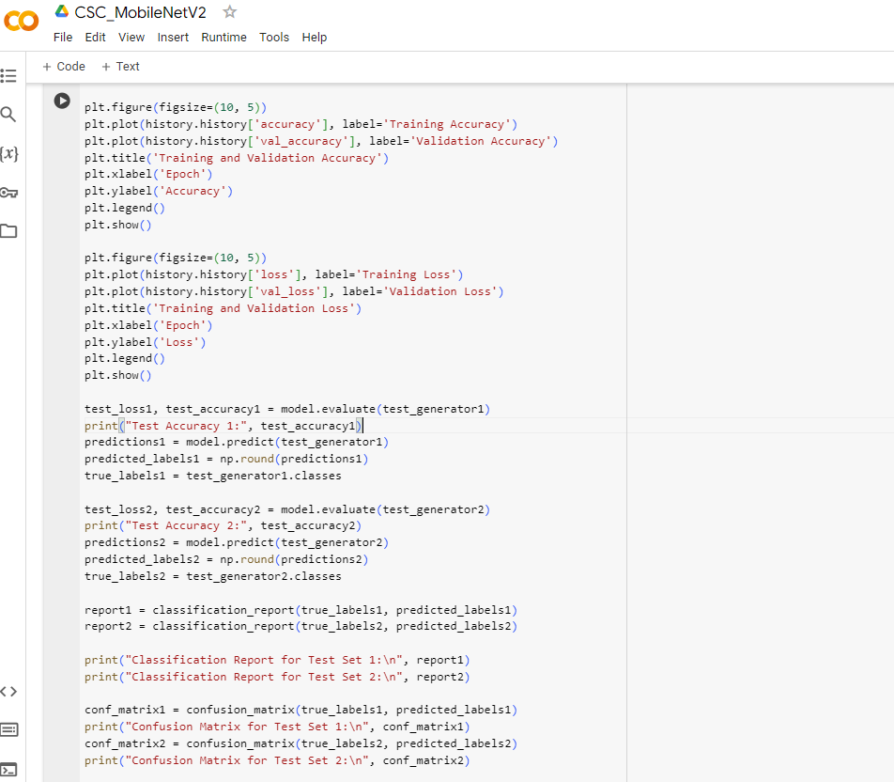

Slide 22
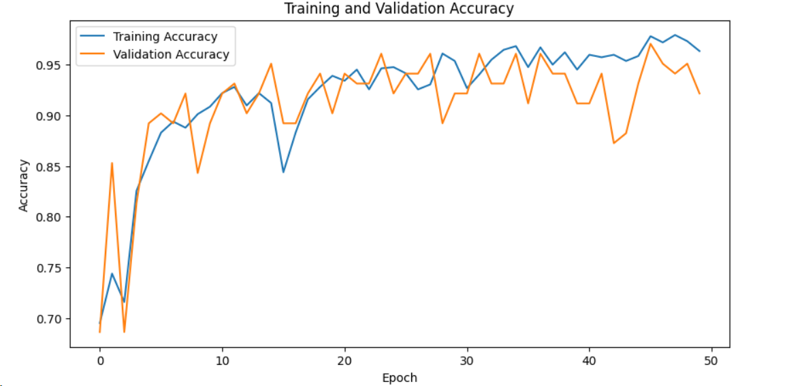
RESULTS
TRAINING ACCURACY = 96% VALIDATION ACCURACY = 92%

Slide 23
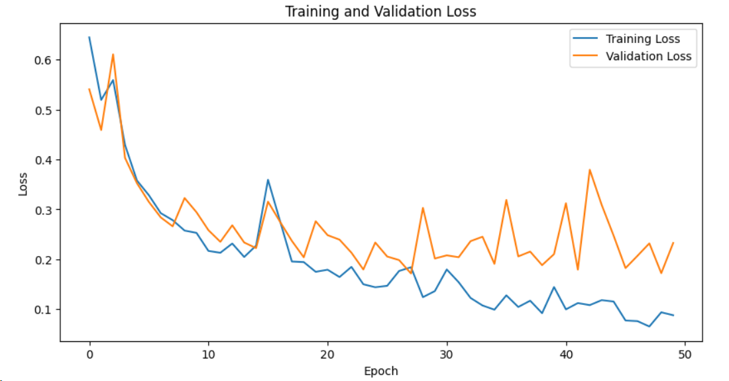
RESULTS
TRAINING LOSS = 8% VALIDATION LOSS = 22%

Slide 24
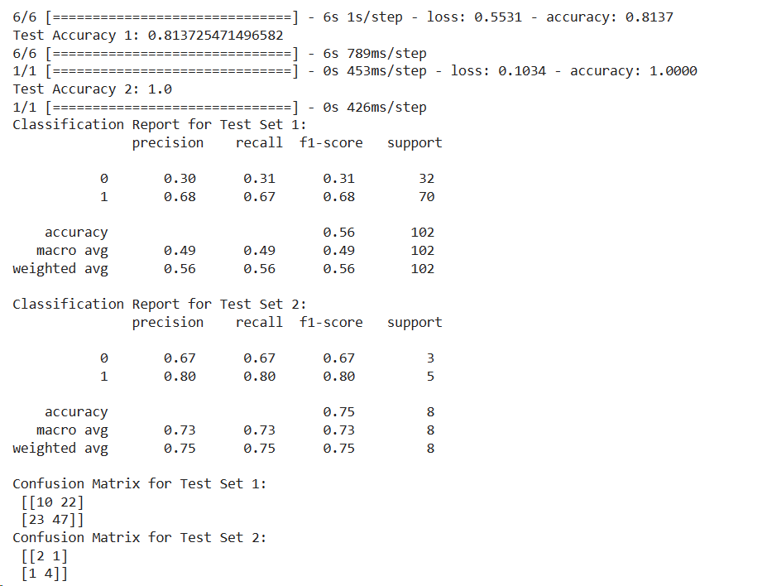
RESULTS
TEST DATASET-1:
ACCURACY = 81%
LOSS = 55%
TEST DATASET-2:
ACCURACY = 99%
LOSS = 1%

Slide 25
[1] EHSANALLAH AFSHARI SAFAVI, “ASSESSING MACHINE LEARNING TECHNIQUES IN FORECASTING LUMPY SKIN DISEASE OCCURRENCE BASED ON METEOROLOGICAL AND GEOSPATIAL FEATURES,” IN TROPICAL ANIMAL HEALTH AND PRODUCTION, JANUARY 2022.
[2] GAURAV RAI, NAVEEN, AQUIB HUSSAIN, AMIT KUMAR AND RAHUL NIJHAWAN,
“A DEEP LEARNING APPROACH TO DETECT LUMPY SKIN DISEASE IN COWS,” LNDECT,VOLUME 66, FEBRUARY 2020.
[3] MUSA GENEMO, “DETECTING HIGH-RISK AREA FOR LUMPY SKIN DISEASE IN CATTLE USING DEEP LEARNING FEATURE,” VOLUME: 3 ISSUE: 1, FEBRUARY 2023.
[4] OLATAYO MOSES OLANIYAN, OLUSOGO JULIUS ADETUNJI, ADEDIRE MARQUIS FASANYA, “DEVELOPMENT OF A MODEL FOR THE PREDICTION OF LUMPY SKIN DISEASES USING MACHINE LEARNING TECHNIQUES,” OCTOBER 2023.
[5] TOYAL MAZI, S. THARUN KUMAR REDDY, B. RAKESH, N. CHANDU,
“A SURVEY ON DEEP LEARNING METHOD TO IDENTIFY LUMPY SKIN DISEASE IN COWS,” JANUARY2023.
[6] V.SIVAMURUGAN, K.R. UTHAYAN, AND V. THANIKACHALAM, “COW DISEASE (LSD) CLASSIFICATION SYSTEM FOR PREDICTING DIFFERENT SEVERITY LEVELS,”
2022.
References

Slide 26
Thank You

